Slide 1


Tableau CAPSTONE
PRESENTATION
Presented by Omolara Buhari
Data analytics EU –class B-Cohort 25-04
Tableau Capstone project: Analysis of Choco de Luxe

Slide 2
Presentation Outline
Snapshot of Choco de Luxe
Problem statement
Aim of the project
Key objectives
Insight into each business question
Recommendations
Dashboard

Slide 3

Introduction

Slide 4

Snapshot of choco de luxE
Choco de Luxe is a premium artisanal chocolate brand headquartered in Brussels, Belgium, with operations across several European cities. The company distributes its chocolate bars, bites, and confections through multiple channels: retail outlets, online platforms, and supermarkets.
With a growing product line and expanding footprint across Europe, they aim to maintain high-quality standards while increasing market share and adapting their product and sales strategy based on regional performance and customer preferences

Slide 5
Problem Statement
Despite strong product quality and market presence, Choco de Luxe lacks a unified, data-driven view of how its products, salespeople, and delivery strategies are performing across Europe.
The leadership team is particularly concerned about underperforming cities, inconsistent delivery statuses, and the need to align pricing, promotion, and product mix with evolving customer behavior. They need actionable insights to optimize sales strategy, delivery efficiency, and regional performance

Slide 6
Aim of the project
To analyze Choco de Luxe's sales performance across various locations, sales channels, and product lines
Identifying patterns, inefficiencies, the workforce, and growth opportunities
Produce interactive Tableau dashboards to help business leaders make informed decisions on product positioning and channel strategy

Slide 7
KEY OBJECTIVES
Key
Key Objectives:
Cleaning
Data Cleaning: Prepare clean, accurate datasets for reliable analysis.
Use
Data Analysis: Use Tableau tools (Tableau Desktop, Tableau Public, Tooltips, Marks, colors, charts, maps, text, and objects to uncover trends and patterns.
Design
Dashboarding: Design a clear visual dashboard using charts, Tableau objects, containers, tiled, floating, and slicers to present insights.
Deliver
Business Insights: Deliver actionable recommendations based on data findings to guide strategic decisions.

Slide 8
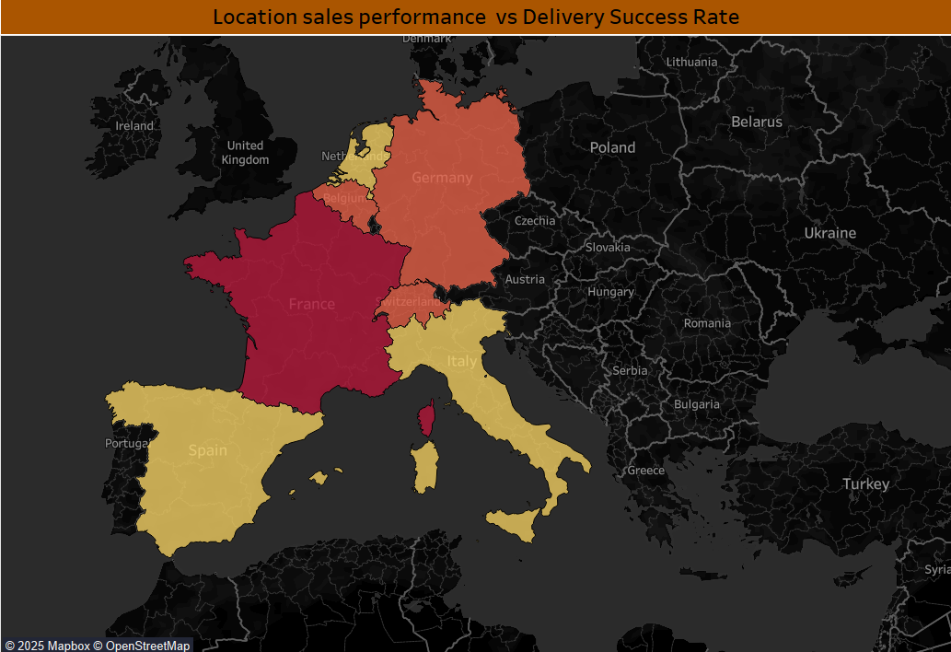
Location Sales Performance:
Compare sales volume and delivery success to identify high-performing vs underperforming locations
Italy (€ 1,026,368), Spain (€ 1,004,109), and the Netherlands(€ 980,001) are the top revenue drivers. While Germany(€ 626,039), Belgium(€ 638,497), Switzerland(€ 687,422) and France(€ 358,260) underperform relative to their market size.
This highlights strong opportunities in Southern Europe and the Netherlands, but also signals the need to improve sales strategies or delivery performance in France, Germany, Switzerland, and Belgium
Eastern Europe is untapped because of no revenue presence

Slide 9
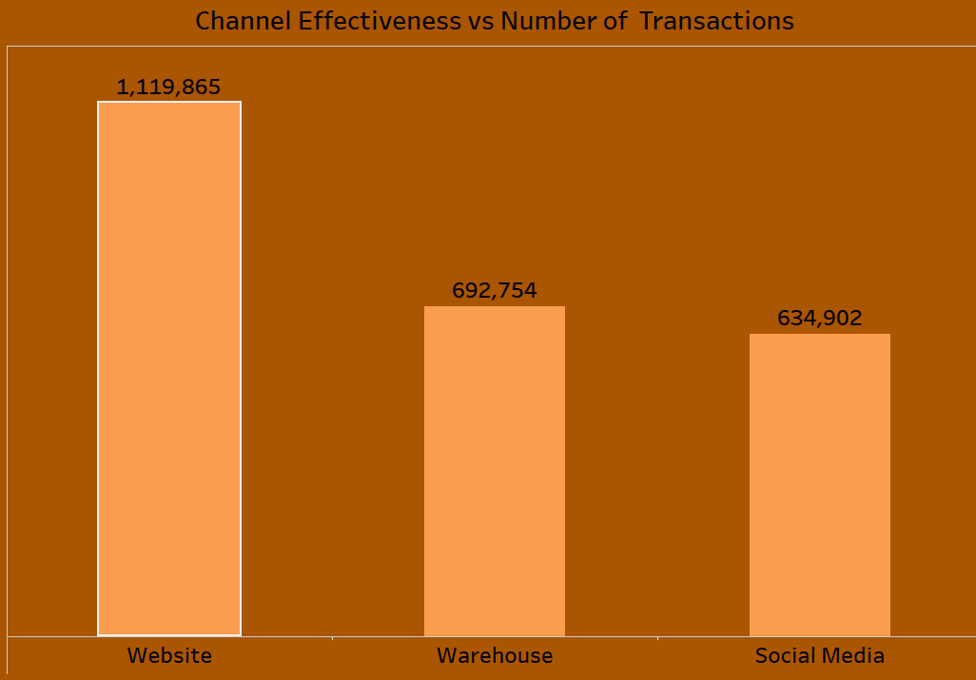
Channel Effectiveness:
Analyze how different sales channels impact the profitability and number of transactions
The website channel delivers the highest profit (€1.12M) with 496 transactions, proving to be the most effective. The Warehouse (€692K, 299 transactions) and Social Media (€635K, 299 transactions) generate similar transaction volumes but lower profits, suggesting the website is the strongest sales driver. At the same time, other channels need optimization to increase profitability.

Slide 10
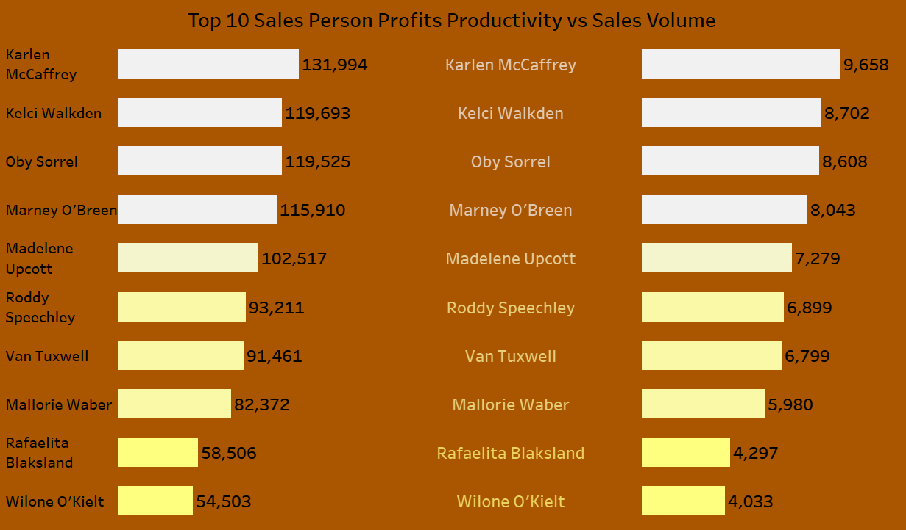
Salesperson Productivity:
Examine individual salesperson performance by volume and value, assuming the profit target for each salesperson is € 100,000
4 out of 10 salespeople exceeded the profit target (€100K):
Karlen McCaffrey (€131,994), Kelci Walkden (€119,693), Oby Sorrel (€119,525), Marney O’Brien (€115,910)
Madeline Upcott (€102,517) just met the target.
The remaining 5 salespeople fell short, with the lowest performers being Rafaëlita Blaksland (€58,506) and Wilone O’Kielt (€54,503).
In terms of sales volume, Karlen McCaffrey also leads (9,658), showing both high volume and high profitability.
Others, like Rafaëlita Blaksland and Wilone O’Kielt, had low volume and low profits, indicating underperformance.

Slide 11
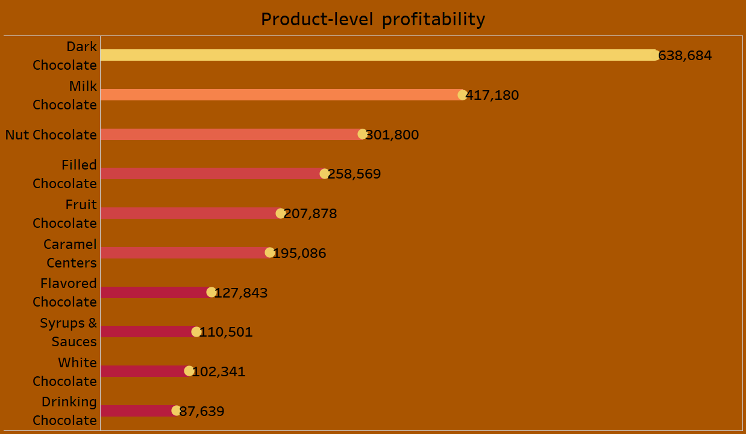
Product-Level Profitability:
Evaluate margin contributions based on product line and product category
Dark Chocolate leads with the highest profit (€638,684) → core profit driver
Milk Chocolate follows strongly at €417,180, showing consistent demand
Nut Chocolate (€301,800) and Filled Chocolate (€258,569) are solid mid-range performers.
Fruit Chocolate (€207,878) and Caramel Centers (€195,086) contribute moderately.
Flavored, Syrups & Sauces, White Chocolate, and Drinking Chocolate generate lower profits (all under €130K), with Drinking Chocolate the weakest (€87,639).

Slide 12
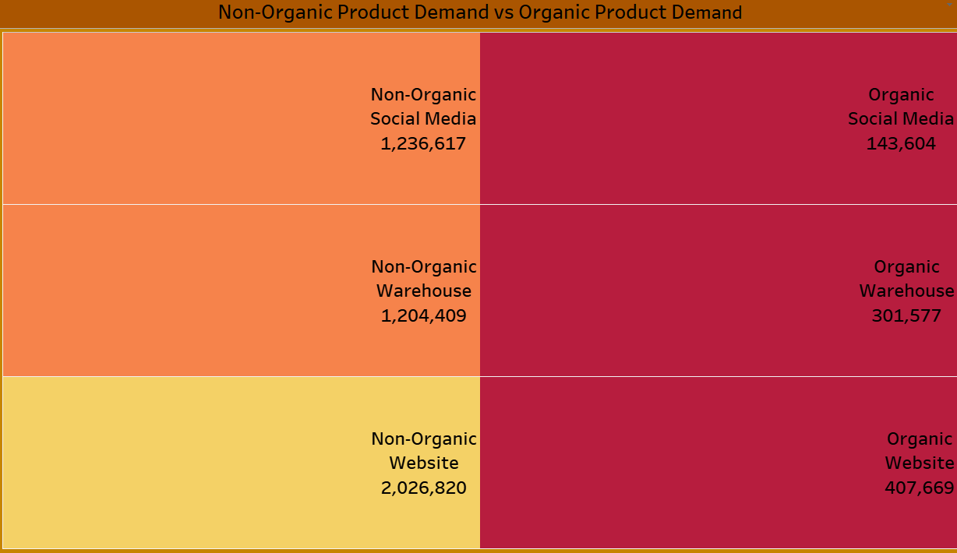
Organic Product Demand:
Compare Organic vs. non-organic product performance by sales channel to inform future product development and marketing
Non-organic products generate the highest demand across all channels, with the website leading (€2.03M), followed by social media (€1.24M) and warehouse (€1.20M). Organic products show much lower revenue, led by the website (€408K), then warehouse (€302K), and social media (€144K). This indicates that while non-organic dominates sales, the website is also the strongest channel for organic growth potential.

Slide 13
Recommendation
a) Strengthen Core Markets
Focus on Italy, Spain, and the Netherlands, where sales are highest, ensuring delivery success stays strong.
Improve penetration in France, Germany, Switzerland, and Belgium through targeted marketing and optimized logistics
b) Channel Optimization
Website is the most profitable channel; continue investment in e-commerce.
Enhance social media and warehouse channels to increase profit per transaction.
c) Salesforce Development
Reward and retain top performers (McCaffrey, Walkden, Sorrel, O’Brien).
Provide training and support for underperforming sales staff to reach the €100K profit target.

Slide 14
Recommendation
d) Product Strategy
Maintain strong momentum in Dark and Milk Chocolate, the top profit drivers.
Explore product innovation and promotions to boost weaker lines (e.g., Drinking Chocolate, White Chocolate)
e) Organic vs Non-Organic Growth
Non-organic drives bulk revenue, but organic shows growth potential.
Leverage the website and social media to promote organic products and capture health-conscious customers.

Slide 15
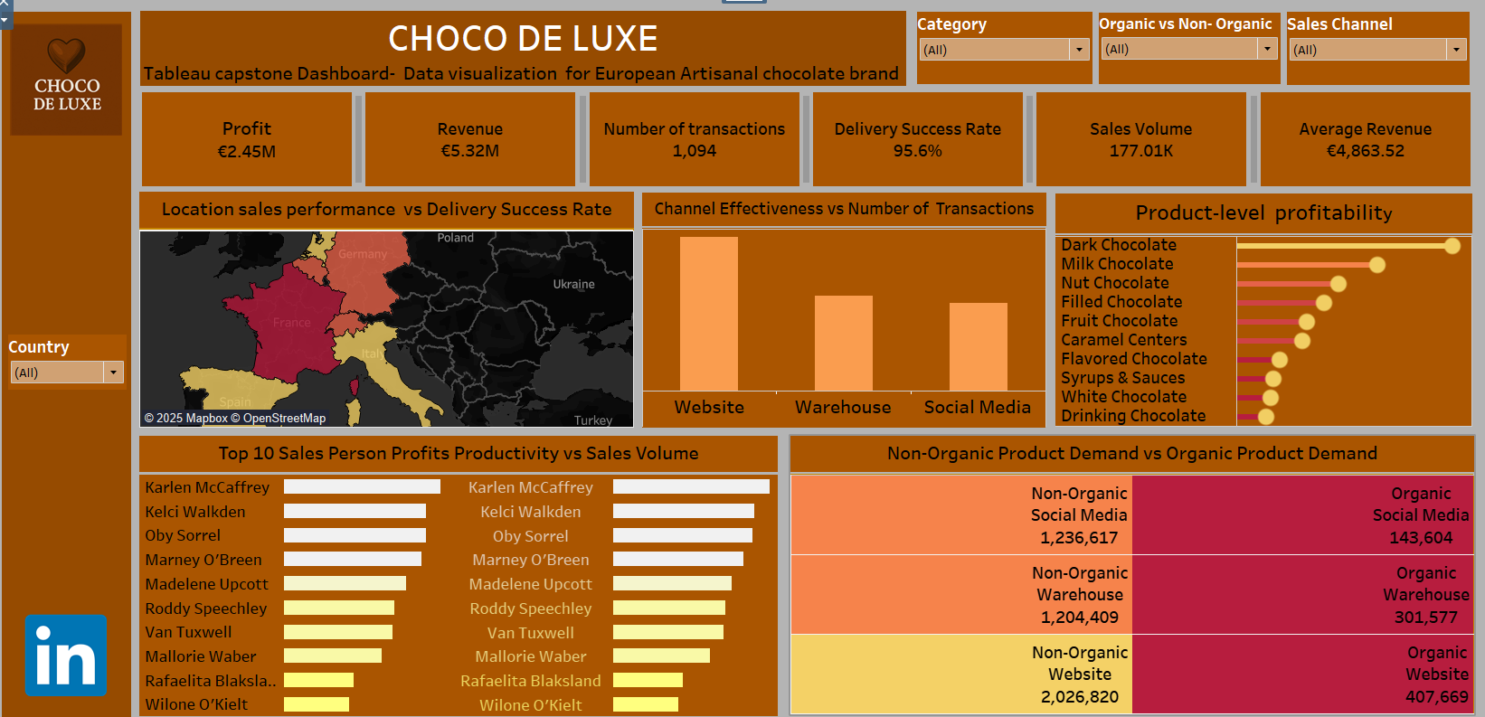

Slide 16
Tableau CAPSTONE PRESENTATION
Presented by Omolara Buhari
Data analytics EU –class B-Cohort 25-04
Tableau capstone project: Analysis of Choco de Luxe

